Slide 1
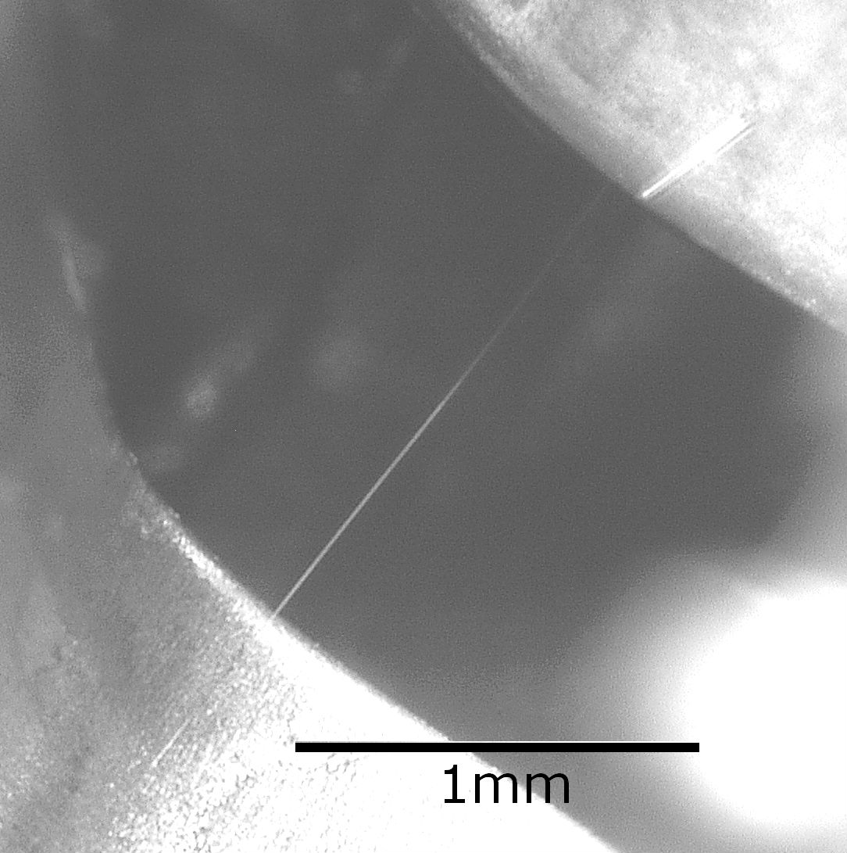
Electrical Failure of an
Accelerator Pedal Position Sensor
Caused by a Tin Whisker and Discussion of Investigative Techniques Used for Whisker Detection
Henning Leidecker
NASA Goddard
henning.w.leidecker@nasa.gov
Lyudmyla Panashchenko
NASA Goddard
lyudmyla.panashchenko@nasa.gov
Jay Brusse
Dell Federal Government Services
jay.a.brusse@nasa.gov

Slide 2
Outline
About Us
Investigation of a failed Accelerator Pedal Position (APP) Sensor due to a Tin Whisker
Important Guidelines for Troubleshooters of Anomalies Related to Metal Whiskers

Slide 3
About Us
Metal Whisker Investigation Team at NASA Goddard Space Flight Center
  H. Leidecker, M. Sampson, L. Panashchenko, J. Brusse, J. Kim
Widely recognized for our Metal Whisker WWW site
  http://nepp.nasa.gov/whisker
Published study of 11+ year evaluation of conformal coating for whisker mitigation
Numerous other publications on metal whiskers (tin and zinc whiskers)
>10 years experience with anomalies related to metal whiskers
  Aerospace: Satellites and Space Shuttle
  Military: Missile Systems, Ordinance Fuzes
  Industrial: Nuclear and other Power Plants, Paper Mills,
  Non-interruptable Power Supplies
  Automotive: Speedometers and other gauges, “DOA” cars
  Others
Supporting members of the NESC Toyota Investigation Team

Slide 4
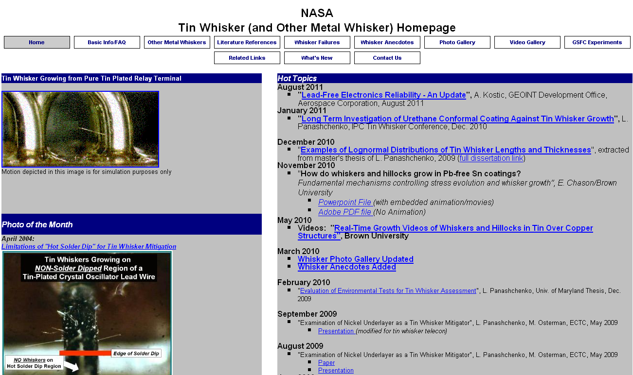
https://nepp.nasa.gov/whisker

Slide 5
Focus of this Presentation
Describe the failure of a Accelerator Pedal Position (APP) sensor caused by a TIN WHISKER*
Describe the failure analysis methods used to identify TIN WHISKERS as the root cause of failure
Convey guidance to failure analysts/troubleshooters for improved techniques to electrically detect metal whisker-induced short circuits
(*) VOQ# 10304368, Available on: http://www-odi.nhtsa.dot.gov/complaints/

Slide 6
Source of APP Sensor
In March 2010, Dept. of Transportation (DoT) contacted the NASA Engineering & Safety Center (NESC – HQ in Langley, VA) for support
In February 2011, the DoT published the 200+ page NESC report entitled:
  Technical Support to the National Highway Traffic Safety Administration (NHTSA) on the Reported Toyota Motor Corporation (TMC) Unintended Acceleration (UA) Investigation
    http://www.nhtsa.gov/UA
    http://www.nhtsa.gov/staticfiles/nvs/pdf/NASA-UA_report.pdf

Slide 7
Extract from NASA Findings
Destructive physical analysis of a failed pedal assembly from a consumer vehicle with a diagnostic trouble code found a tin whisker had formed a 248 ohm resistive short between VPA1 and VPA2
A second tin whisker of similar length was growing from a 5 volt source terminal adjacent to a pedal signal output terminal, but had not made contact with any other terminals. Inspection of “non-failed” potentiometer pedals revealed tin whiskers present in similar locations as the failed pedal
Notes:
Destructive physical analysis shows the Denso Hall Effect accelerator pedal sensor is protected against the tin whisker resistive shorts
The CTS pedal provides physical separation between the VPA1 and VPA2 thereby removing one component of the dual fault scenarios
In this case, the first of two perfect resistive shorts occurred! However, the fail safe system worked
And we found no reasonable way for this failure type to occur in 2007 Toyota Camry and later accelerator pedal assemblies

Slide 8
Extract from NASA Findings
Vehicle testing of a MY 2005 Toyota Camry demonstrated that a 248 ohm short between VPA1 and VPA2 results in different vehicle responses depending on the sequence of operations following the fault
  If the pedal is depressed quickly, then throttle is limited to 15 degrees
  If the pedal is depressed slowly, then throttle can jump to 15 degrees, and further pedal application can achieve wide open throttle
In all cases, releasing the accelerator pedal closes the throttle, and brakes are fully operational
  Although the vehicle would operate, we did not consider it to be driveable

Slide 9
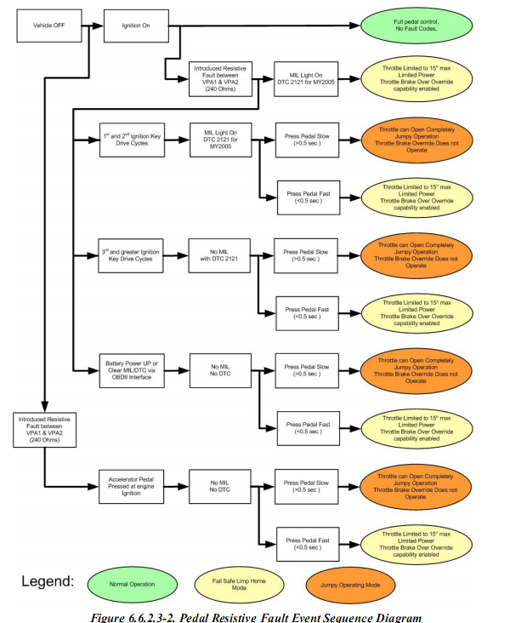
Event Sequence Chart
This chart is not self-contained, but requires the materials in the section 6.6.2.3.1 of the NESC Technical Assessment Report
  Technical Support to the National Highway Traffic Safety Administration (NHTSA) on the Reported Toyota Motor Corporation (TMC) Unintended Acceleration (UA) Investigation , February 2011. Page 115, Figure 6.6.2.3-2
    http://www.nhtsa.gov/UA
    http://www.nhtsa.gov/staticfiles/nvs/pdf/NASA-UA_report.pdf

Slide 10
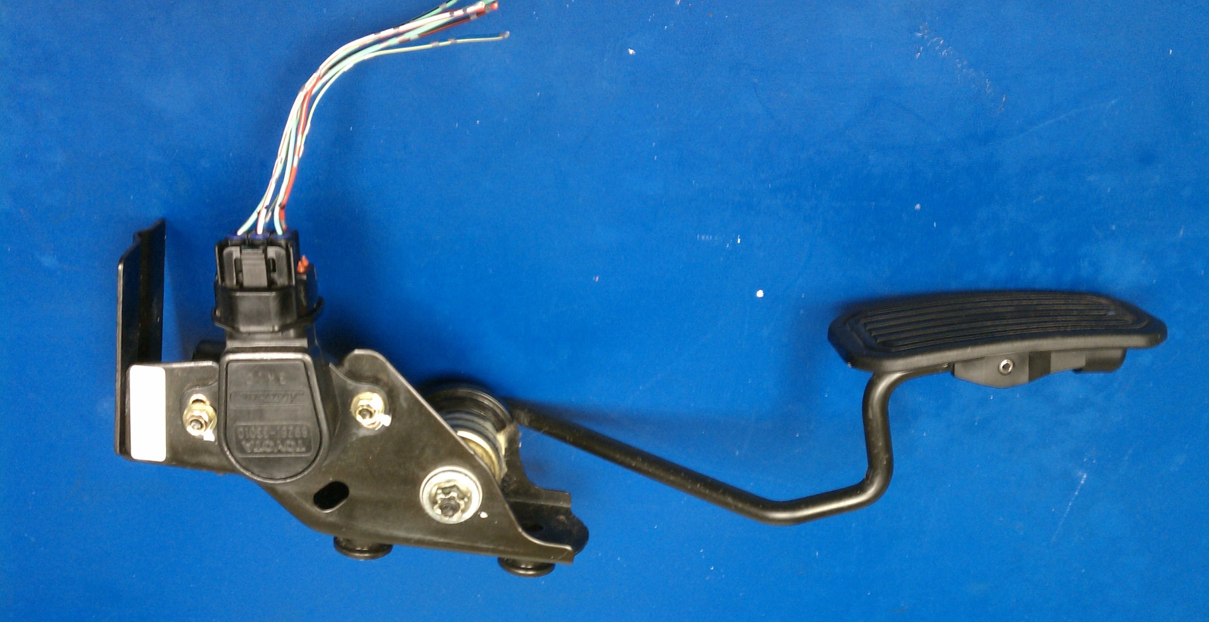
Accelerator Pedal Assembly with
Dual Potentiometer
Accelerator Pedal Position (APP) Sensor
Dual Potentiometer
APP Sensor
4cm

Slide 11
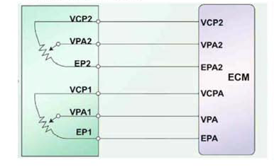
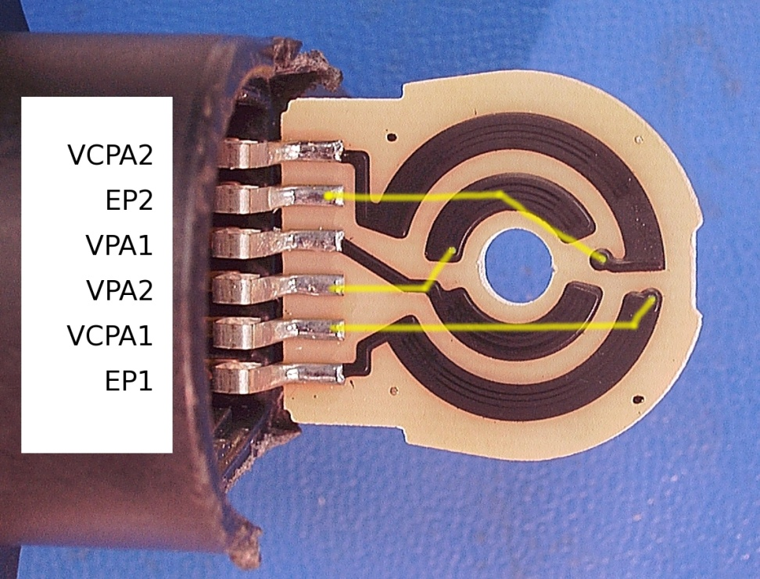
Overview of a
Dual Potentiometer-Based APP Sensor
Architecture Dual Potentiometer APP Sensor
For Camry MY 2002 - 2006
Actual Dual Potentiometer
APP Sensor (partially disassembled)
Source: NESC "NHTSA Toyota UA Investigation", January 18, 2011 Figure 6.4.1.3-1
Signal Line Labels:
VCP1, VCP2 = voltage supply fixed at 5.0 volts for potentiometers 1 and 2, respectively
VPA1, VPA2 = sliding tap, producing a voltage between VCP1, VCP2 (respectively) that is linear with pedal displacement – these are the voltage signals sent to the engine control module to control the throttle position
EP1, EP2 = system ground at 0.0 volts for potentiometers 1 and 2, respectively ("E" = "Earth")
Notes:
There is ambiguity in terminology used to describe pin out/function within the Toyota service manual literature: for example, VCP2 = VCPA2

Slide 12

Partially Disassembled
Dual Potentiometer-Based APP Sensor
Ribbon Leads are a Copper Alloy Coated with 2 μm of Pure Tin
  Confirmed by XRF & EDS
No other coatings present on Ribbon Leads (i.e., no conformal coating over them, no intermediate plating layers)
Separation between adjacent terminals varied from 1000 to 1500 μm
Dual potentiometers produce independent electrical signals based upon pedal depression angle (VPA1 and VPA2)
Tin-plated Cu alloy

Slide 13
Source of Accelerator Pedal Assembly Provided to NASA Metal Whisker Team http://www-odi.nhtsa.dot.gov/complaints/
Make : TOYOTA Model : CAMRY Year : 2003
Manufacturer : TOYOTA MOTOR CORPORATION Crash : No
Fire : No Number of Injuries: 0
ODI ID Number : 10304368 Number of Deaths: 0
Date of Failure: November 11, 2009
Component: VEHICLE SPEED CONTROL: ACCELERATOR PEDAL
Failure Mileage: 81,957 (information courtesy of DOT)
Summary:
I HAVE A 2003 CAMRY. ON NOV. 8, 2009 I HAD A VERY BIG PROBLEM WITH THE ACCELERATOR. WHEN STEPPING ON THE GAS PEDAL I COULDN'T GET ANY GAS, AND THEN THE CAR WOULD JERK FORWARD AT A RAPID RATE SO THAT I HAD TO APPLY THE BRAKES. IT WAS TOTALLY UNDRIVABLE.
THE MECHANIC REPLACED THE GAS PEDAL ASSEMBLY, AND I HAVE THE OLD PART IN MY POSSESSION. THE PART WAS $428.01 PLUS THE LABOR COST. MY OLD CAMRY I DROVE FOR 12 YEARS WITHOUT ANY PROBLEMS.
I FEEL THE PART WAS DEFECTIVE AND THAT TOYOTA SHOULD REIMBURSE ME FOR THE COST OF REPLACEMENT. WOULD YOUR AGENCY PLEASE LOOK INTO THIS FOR ME?
  NOTE: NHTSA report states warranty analyses identified at least two additional failures due to tin whiskers in similarly designed APP sensors
Notes:
Note time to failure (~7 years from date of manufacture of APP sensor)… Well beyond warranty….

Slide 14
Failure Analysis of
2003 Camry APP Sensor
Electrical Tests on Receipt by NESC at Goddard
  The presence of a short was explored by using four different ohm-meters, testing on two vehicles and a vehicle simulator
  Each method found a short
Physical Analysis of Internal Components
  Optical Microscopy & Scanning Electron Microscopy (SEM) to inspect for the cause of the short
  X-Ray Fluorescence (XRF) Spectroscopy to determine material composition: elements and thickness of layers
Notes:
ETCS simulator testing duplicated the symptoms reported by the consumer via the NHTSA complaint database

Slide 15
Electrical Tests on
2003 Camry APP Sensor
Resistance measurements between all combinations of external APP sensor connector pins detected an intermittent resistive short between VPA1 and VPA2
  Measurements made using multiple multimeters
  Initially, ~3.5MΩ, dropping to ~5kΩ, and then remaining between 238Ω to 250Ω, until the pedal assembly was mechanically shocked
  Mechanical shock to the pedal assembly returned the resistance to ~3.5MΩ and further pedal actuations dropped the resistance again to ~5kΩ and finally to the range between 238Ω to 250Ω
  This shorting resistance remained unchanged throughout the entire range of travel of the pedal, except when mechanical shocks were delivered
Notes:
Last bullet intended to highlight that at this stage of FA we did not know the location of the resistive short or its cause. There was possibility that the wiper might be involved, but the constancy of the short through range of pedal depression suggested it was NOT the wipers

Slide 16
NASA GSFC Parts Analysis Lab
APP sensor brought into the parts analysis lab at Goddard for further analysis
  Intermittent resistance behavior confirmed
Disassembly methods chosen to preserve evidence of conductive debris
  Plastic housing removed without delivering shocks or introducing debris
  Shorting resistance was continually monitored using a Fluke 87V multimeter in series with a 100kΩ protection resistor, and shown to remain at 238Ω throughout disassembly, except for several excursions to “open circuit” (>50MΩ) followed by return to about 238Ω
VPA1
R_{S} ~ 100 kohms
Ω
R_{Whisker}
VPA2

Slide 17
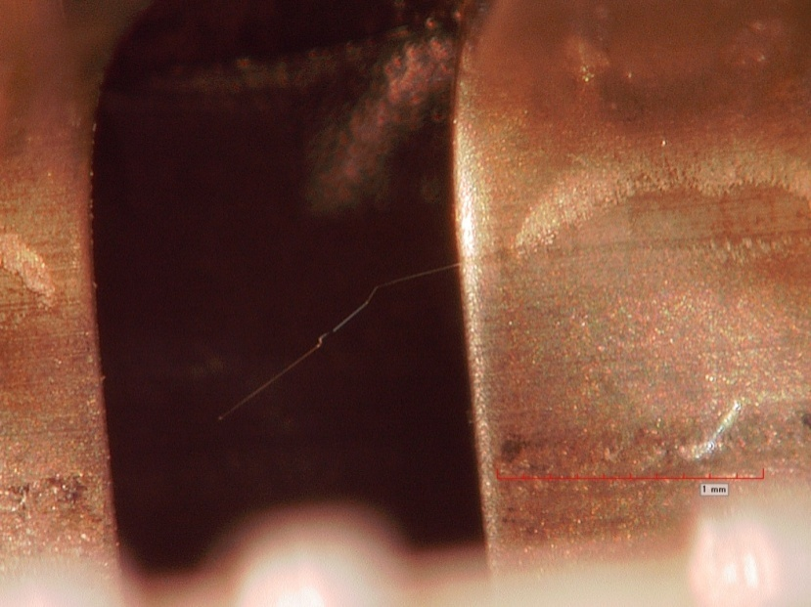
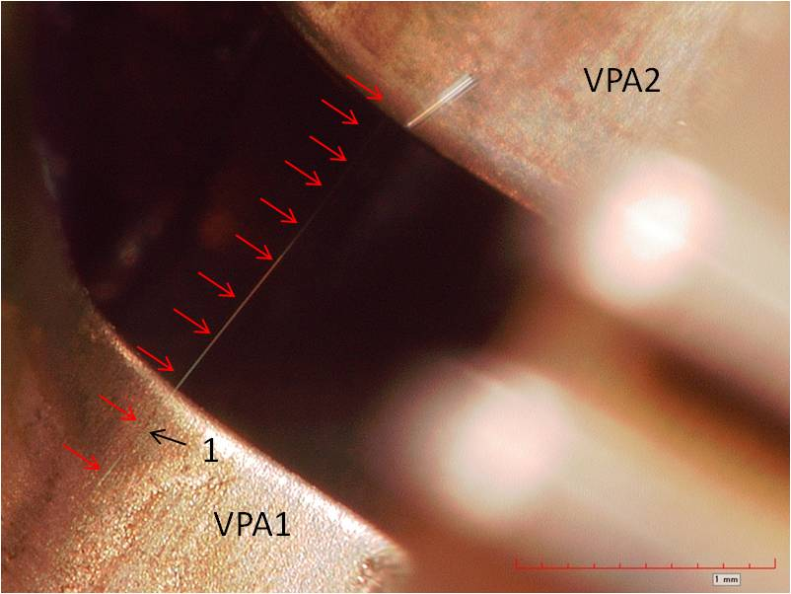
The Two Longest Tin Whiskers Observed in Faulty 2003 Toyota Camry APP Sensor
Tin Whisker Almost Bridging
Between VPA2 and VCPA1
Tin Whisker Shorting
Between VPA1 and VPA2
VPA2
1.5mm
1.9mm
VPA2
VCPA1
1mm
VPA1
1mm

Slide 18
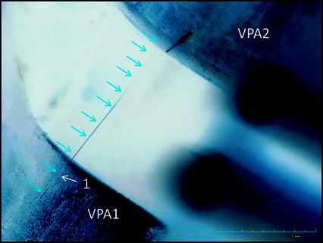
Whiskers in Faulty 2003 Toyota Camry APP Sensor
1.9mm
Notes:
Apparent width shown at lower left is ~5 pixels. Actual width is ~0.4 pixels. Thus the increase by a factor of 12x is due to light scattering in the optics of microscope and the camera detector.
Whisker root is at lower left. Although it’s width appears to change along its length, we can be sure this is not the case. The apparent change in width is an artifact of the optics. The reflection is large and several detector pixels are illuminated at the left. On the right the reflection dims and only a fraction of a pixel is illuminated thus giving an apparent (but unreal) change in thickness along the length. The thickness of the whisker here is actually 2000x smaller than the

Slide 19
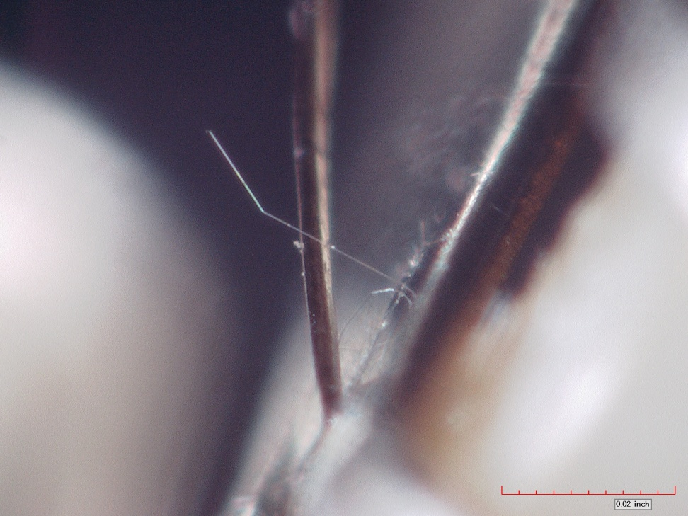
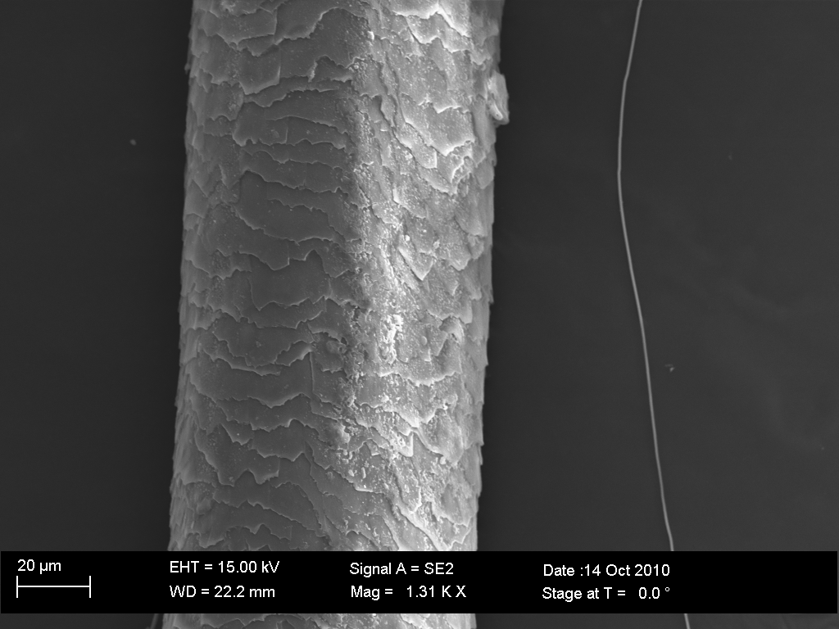
Human Hair vs. Metal Whisker
Metal Whiskers are commonly
1/10 to <1/100 the thickness of a human hair
Optical comparison of
Human Hair vs. Tin Whisker
SEM comparison of
Human Hair vs. Metal Whisker
Metal
Whisker
Hair
Metal
Whisker

Slide 20
Calculation of Thickness of the Bridging Whisker from Measured Resistance and Length
  Where ρ = resistivity of Sn ~ 11.5μΩ cm;
  L = length of whisker;
  A = cross sectional area of whisker =
  where d = diameter of whisker (approximating thickness of whisker)
Therefore, since L= 1900 μm, R = 238Ω, then
d ~ 1.1 μm
  This is in line with typical thicknesses of tin whiskers

Slide 21
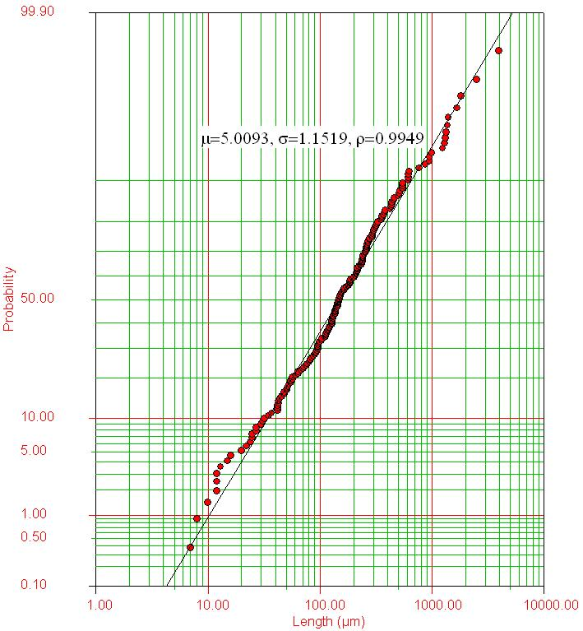
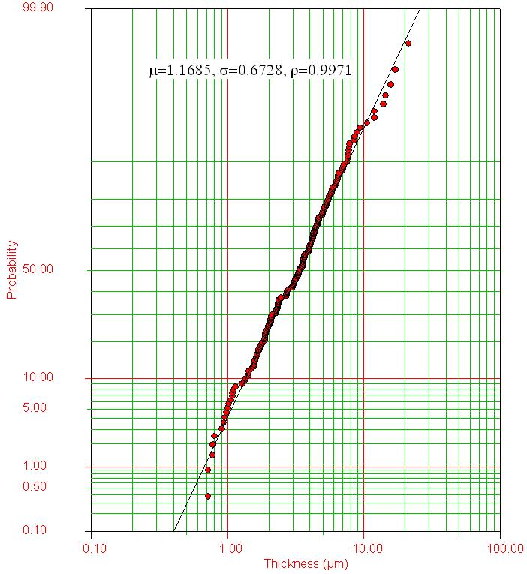
Example of Tin Whisker Length and Thickness Distributions
Collected for 187 whiskers on tin-plated brass that grew over 11 years of ambient storage
Whisker Length
Whisker Thickness
Source: L. Panashchenko “Evaluation of Environmental Tests for Tin Whisker Assessment”, MS Thesis, University of MD, December 2009. Figures 59-60

Slide 22
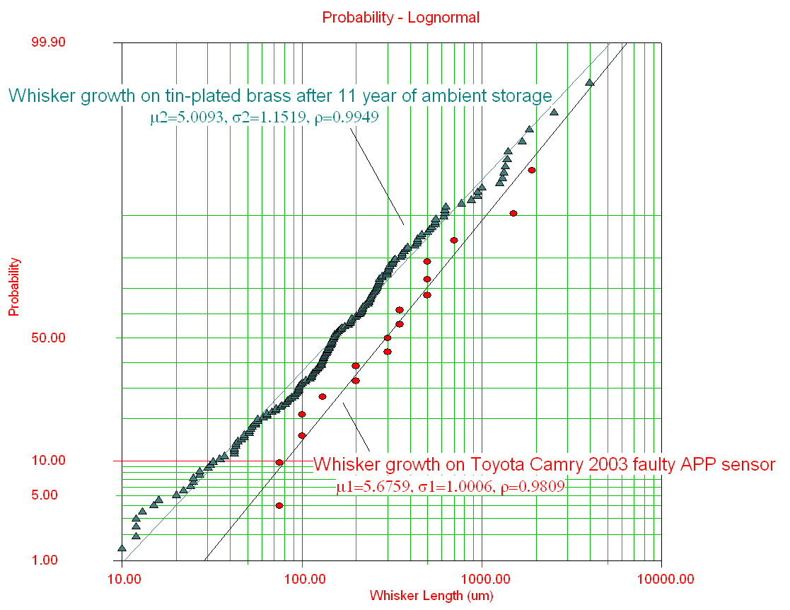
Whiskers >50μm in Length found on the Faulty 2003 Camry APP Sensor
17 whiskers with lengths >50μm were observed on the faulty 2003 Camry APP sensor
  Whisker lengths on APP sensor may actually be longer than shown due to measurement technique
Whisker growth seen on faulty APP sensor is not ‘out of family’
  Compare to whisker length data collected for tin-plated brass after 11 years of ambient storage*
(*) L. Panashchenko, J. Brusse, H. Leidecker, “Long Term Investigation of Urethane Conformal Coating Against Tin Whisker Growth”, IPC Tin Whisker Symposium, December 2010

Slide 23
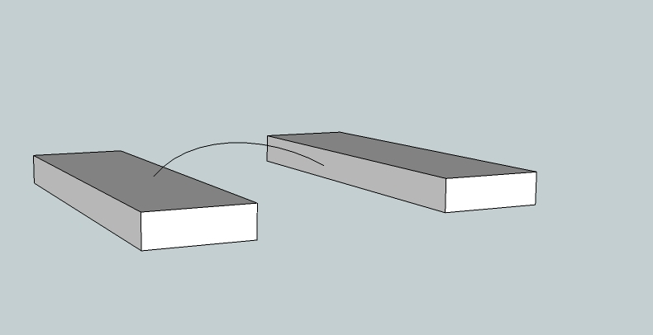
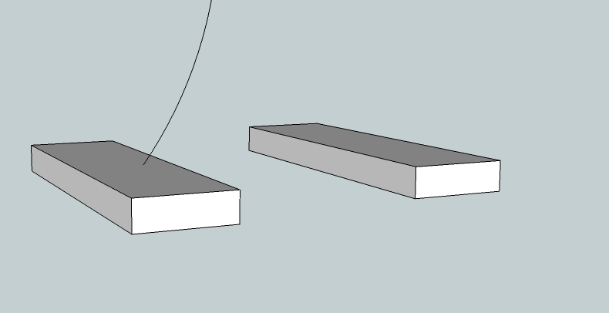


Illustration of How a Whisker may Snag
Whisker in motion
Long, thin whiskers are ductile. Without breaking they can bend, flex through very large angles under the influence of air, vibration, shock, electrostatic forces
After significant movement, whisker tip may be caught by the irregular surface of the tin plating on an adjacent conductor
  Mechanical shock or air movement may dislodge the whisker tip
Insulating films may prevent immediate electrical continuity
  See next slide for more detail
Notes:
ADD IMAGE OF IRREGULAR TIN SURFACE
Videos of waving whiskers coupled with non-moving whiskers
Videos of highly bent whiskers that snap back when released at tip

Slide 24
Metal Whiskers and Adjacent Conductors Grow Insulating Films
Electrically insulating films form within hours on metal whiskers and adjacent conductors
  Oxides, sulphides, sulphates, chlorides, hydrides, etc.
These films act as barriers to electrical current flow UNLESS applied voltage exceeds “dielectric breakdown” strength of the combined films
  Direct MECHANICAL contact does NOT guarantee ELECTRICAL contact
  Courey (NASA), among others, have measured the breakdown voltage of films on tin whiskers
    V_{BD} fit a probability distribution with a wide range (~60mV to >45Volts)
  Insulating effects of these films are important to recognize
    Has fooled failure analysts when bench testing (e.g., Ohm-meter) to detect shorts
    Can explain survival of some electronics in the field despite whisker infestation
Insulating Films
(not to scale)
Whisker
Growth
Surface
+
Metal Whisker
Conductor
V_{supply}

Slide 25
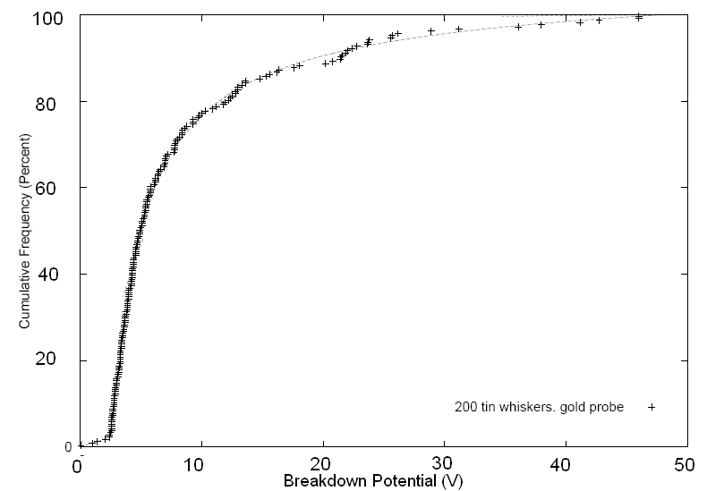
Breakdown Potential of Insulating Films on 200 Tin Whiskers from ~19 Year Old Space Shuttle Hardware when probed using gold-plated probe
A few observations:
Abrupt transition ~2.6V
  Larger sample size might better define
  distribution < 2.6V
Median V_{BD} = 4.9V
Accumulation of insulating films on
these samples may be extensive
due to age of specimens (19 years)
Analysis of Data from PhD Dissertation of
Courey, K., “An Investigation of the Electrical Short Circuit
Characteristics of Tin Whiskers”, 2008-03-04
http://etd.library.miami.edu/theses/available/etd-03082008-125933/
~2.6V
Notes:
This data addresses tin whisker with its insulating films contacting a gold-plated probe (no insulating films). In other scenarios (e.g., Toyota APP sensor), the tin whisker (with insulating film) is contacting an adjacent tin-coated surface ALSO with its own insulating films. This condition shifts the Vbd distribution to the right (i.e., higher voltage needed to overcome both insulating films)

Slide 26
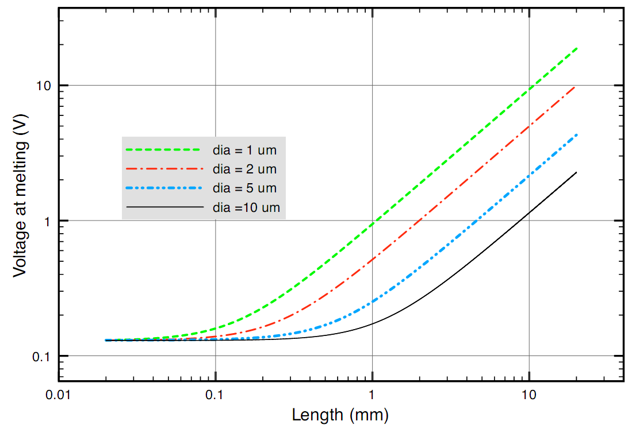
Melting Voltage vs. Length for Selected Whisker Diameters
Based on: J.H. Richardson, and B.R. Lasley, "Tin Whisker Initiated Vacuum Metal Arcing in Spacecraft Electronics," 1992 Government Microcircuit Applications Conference, Vol. XVIII, pp. 119 - 122, November 10 - 12, 1992.
Notes:
Thinner whiskers are more robust (explain why)

Slide 27
Beware of Ohm-Meter Limitations
Published research shows that ohm-meters detect less than 10% of the bridging whiskers, and sometimes less than 1%
The investigator may conclude “No Fault Found”
  Ohm-meter may supply V_{out} < V_{breakdown} for the insulating films (oxides, moisture) that form on a metal whisker. No Current will flow – the whisker remains undetected during the few seconds of examination.
  “No Fault Found”
  Ohm-meter may supply V_{out} > V_{melt} . Current Will Flow, the whisker melts in less than 1 ms -- no detection happens. There is no longer a bridging whisker to detect.
  “No Fault Found”
Range switching can have the ability to deliver whisker-killing impulses
Notes:
Context of troubleshooting with Ohm-meter vs. whisker bridging in the field. Longer sampling time in-service when a whisker bridges produces greater probability of electrical breakdown

Slide 28

Charybdis and Scylla:
Electrical Detection of Whisker Short
Melting Whisker vs. Insulating Film Interference

Slide 29
Build Your Own Better Whisker Detector!
Use a variable power supply (V_{supply}) and a protective resistor in series (R_{S}) with the whisker to be detected
  Choose R_{S} ~ 100kΩ
  Adjust V_{supply} > V_{breakdown} of insulating films on whisker and conductor being bridged
  When V_{supply} > V_{breakdown}, R_{S} quickly drops V_{whisker} < V_{melt}
Circuit to measure R_{w}
Choose R_{S} such that
V_{whisker} < 80% V_{melt}
A
+
R_{S} ~ 100 kohms
V_{supply}
R_{W}
V_{W}
-
I
WARNING: “DO NO HARM” principle should be applied:
The use of this circuit may be damaging to active parts or powered circuits under test
A high impedance voltage meter should be used for measurements made across a whisker

Slide 30
Summary
A tin whisker induced short was responsible for the failure of a 2003 Toyota Camry Accelerator Pedal Position (APP) Sensor based on a Dual Potentiometer Design
  NHTSA report states warranty analyses identified at least two additional failures due to tin whiskers in similarly designed APP sensors
Use of pure tin coating can result in the formation of tin whiskers
  Tin whiskers are to be expected in other dual potentiometer APP sensors that use tin coatings
Based on published literature, applying less than 2.6V to detect shorting will detect fewer than 2% of bridging whiskers, and most ohm-meters apply less voltage and do not excite a short during the time of investigation
  This also applies to many other circuits: they survive whiskers by failing to break down the oxide
Use of an alternate circuit described herein increases the probability to detect and preserve the tin whisker short
  Care should be taken not to damage the circuit or part under test with the measurement technique

